Slide 1
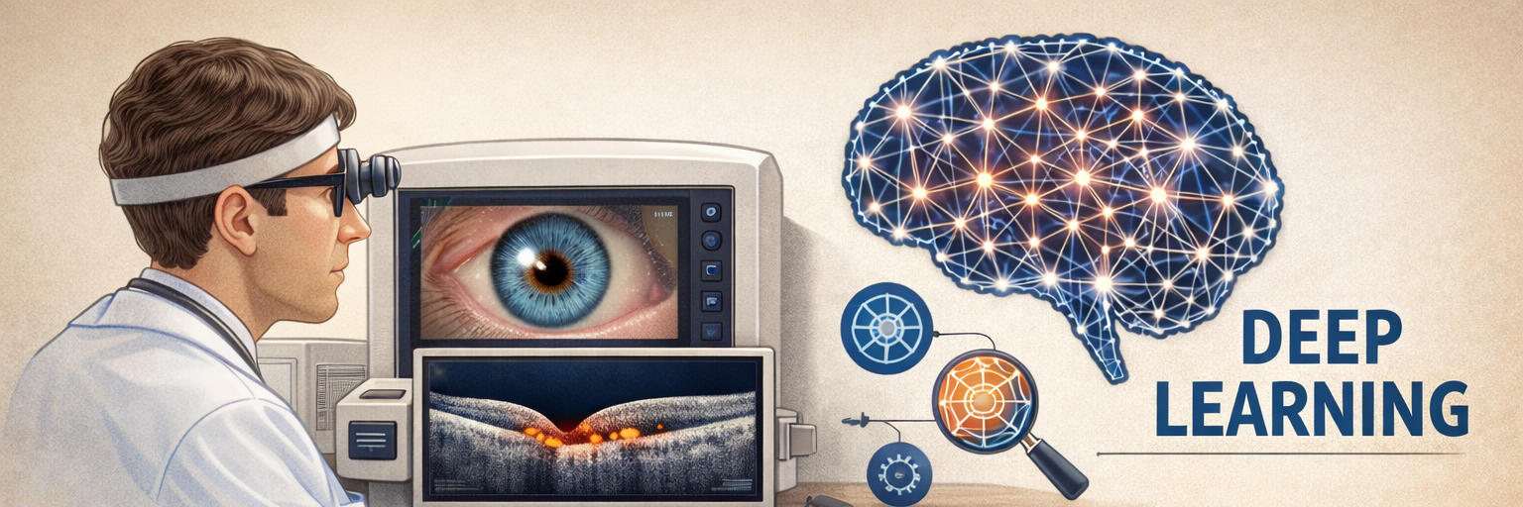
“ResNet-18 and DenseNet-121 Architectures for OCT Retinal Analysis: Effects of Transfer Learning, Data Augmentation, Fine-Tuning Strategies and Model Calibration”
George Dikaios
Emmanouil Amargianitakis
DAMA Hackathon, 2026

Slide 2
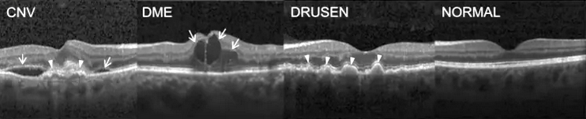
Retinal diseases and OCT-scans for detection
CNV – Choroidal Neovascularization (Figure 1a)
Abnormal blood vessel growth under the retina.
OCT Features: Subretinal fluid, Hyperreflective lesions, Retinal thickening
DME – Diabetic Macular Edema (Figure 1b)
Swelling of the macula due to fluid leakage from damaged blood vessels.
OCT Features: Intraretinal cysts, Retinal thickening, Fluid pockets
Drusen (Figure 1c)
Yellow deposits (lipid/protein) under the retina.
OCT Features: Dome-shaped elevations under RPE, No major fluid accumulation (early stage)
Popular dataset for classification:
Kermany OCT Dataset
Dataset was pre-split into:
Train set 60%
Validation set 20%
Test set 20%
Optical Coherence Tomography (OCT)
is a non-invasive imaging technique that uses light waves to capture cross-sectional images of the retina.
OCT scan reveals:
Retinal layers
Macula thickness
Fluid accumulation
Blood vessel abnormalities
Nerve fiber layer thickness
(a)
(b)
(c)
(d)
Figure 1: (a) Choroidal Neovascularization, (b) Diabetic Macular Edema, (c) Drusen and (d) Normal [taken from Kumar et al. 2017]

Slide 3
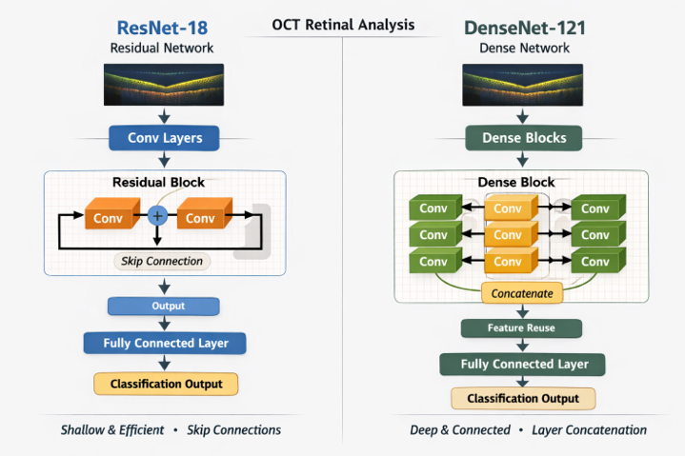
Convolutional Neural Network (CNN) architectures
A) ResNet-18 (11.7 million parameters)
18 weight layers
Uses Basic Residual Blocks
Designed mainly for ImageNet classification
Advantages
Easier to train than traditional deep CNNs
Good tradeoff between speed and accuracy
Lightweight compared to deeper versions (ResNet-50/101/152)
Frequently used in transfer learning
B) DenseNet-121 (8 million parameters)
121 total layers
4 Dense Blocks
3 Transition Layers
Growth Rate (k) = 32
Each layer receives input from all previous layers
Advantages
Strong gradient flow
Feature reuse (earlier features reused later)
Fewer parameters than similar deep networks
Reduces vanishing gradient problem
Figure 2: Comparative CNN architecture of ResNet-18 and DenseNet-121 for OCT retinal image classification.
Feature | ResNet-18 | DenseNet-121
Connections | Addition | Concatenation
Memory Usage | Lower | Higher
Experiments were conducted on an NVIDIA A100 GPU.
Class-weighted Cross Entropy Loss to mitigate class imbalance .
Augmentation techniques were applied (rotation, horizontal flipping, intensity variation, color jitter, Gaussian blur, resizing, normalization, and cropping).
Freezing and unfreezing was utilized (structured into 6 stages consisting of 15 epochs each).
A cosine annealing scheduler was used, with both the scheduler and the learning rate reset at the beginning of each stage.
Checkpoints were used to save each epoch run and also to load the last epoch in case of sudden shut down.

Slide 4
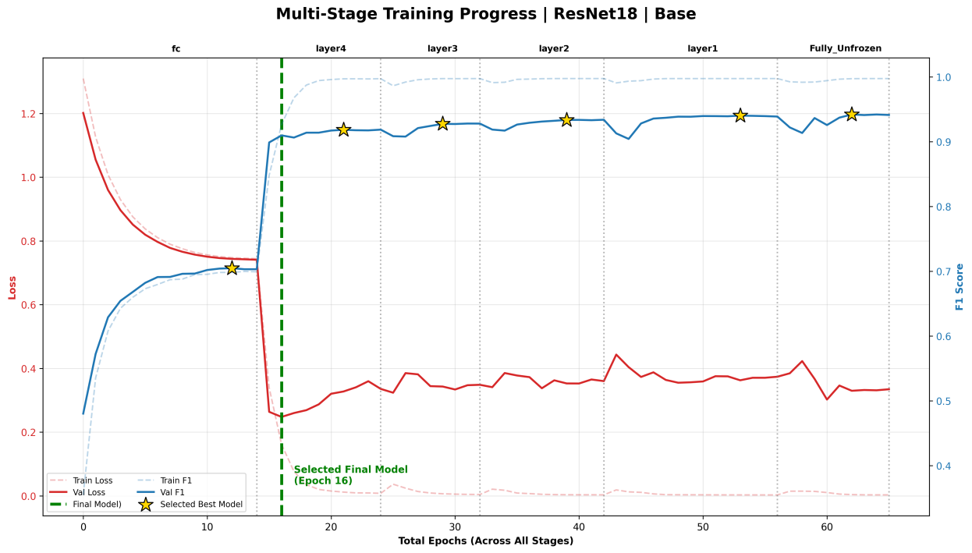
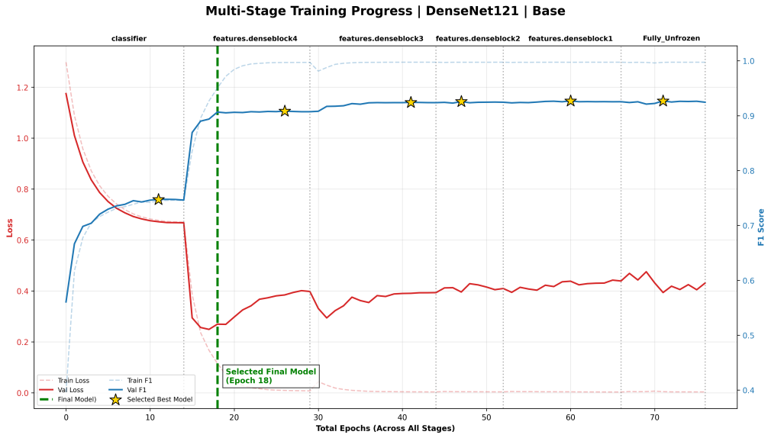
Training Phase of “Base” CNNs
(A)
(A) RensNet-18 [Base] :
Batch size was consistently 512.
Learning rate was resetting to 1 × 10⁻⁴.
Early stopping: patience of 3 epochs (Δmin = 0.0005) based on macro F1-Score.
(B) DenseNet-121 [Base]:
Batch size was 512 (initially) then reduced to 256 from stage 4 onward.
Learning rate was 1 × 10⁻⁴ for the first 3 stages and then reduced to 1 × 10⁻⁵.
Early stopping: patience of 5 for both macro F1-score (Δmin = 0.0005) and validation loss.
(B)
No Augmentation (Base)
Val Loss was going up or stable
Train Loss ∼ 0
Train F1-Score ∼ 1
Clear signs of overfitting

Slide 5
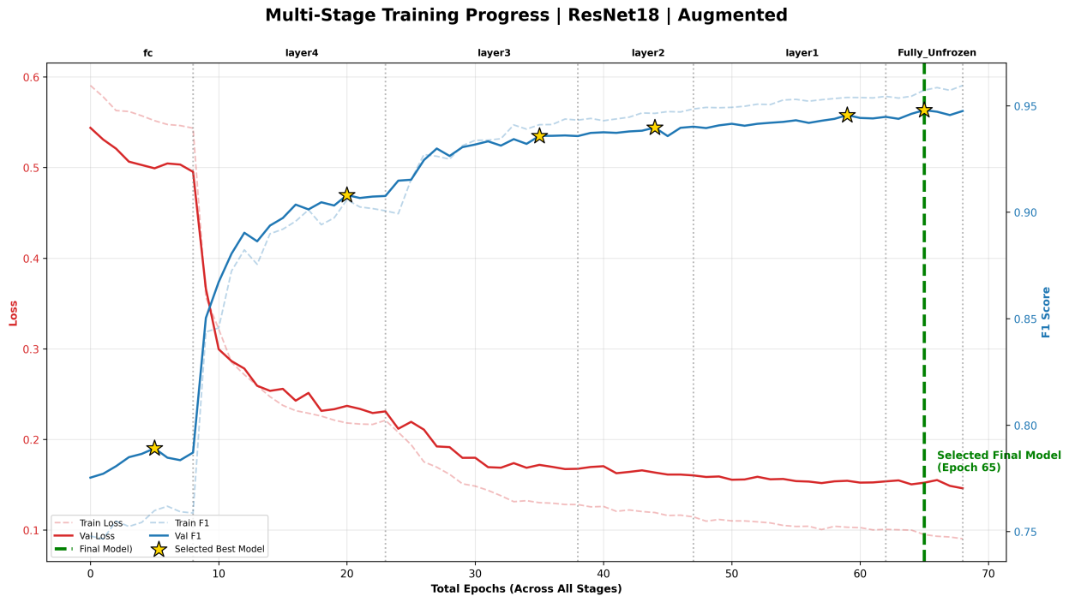
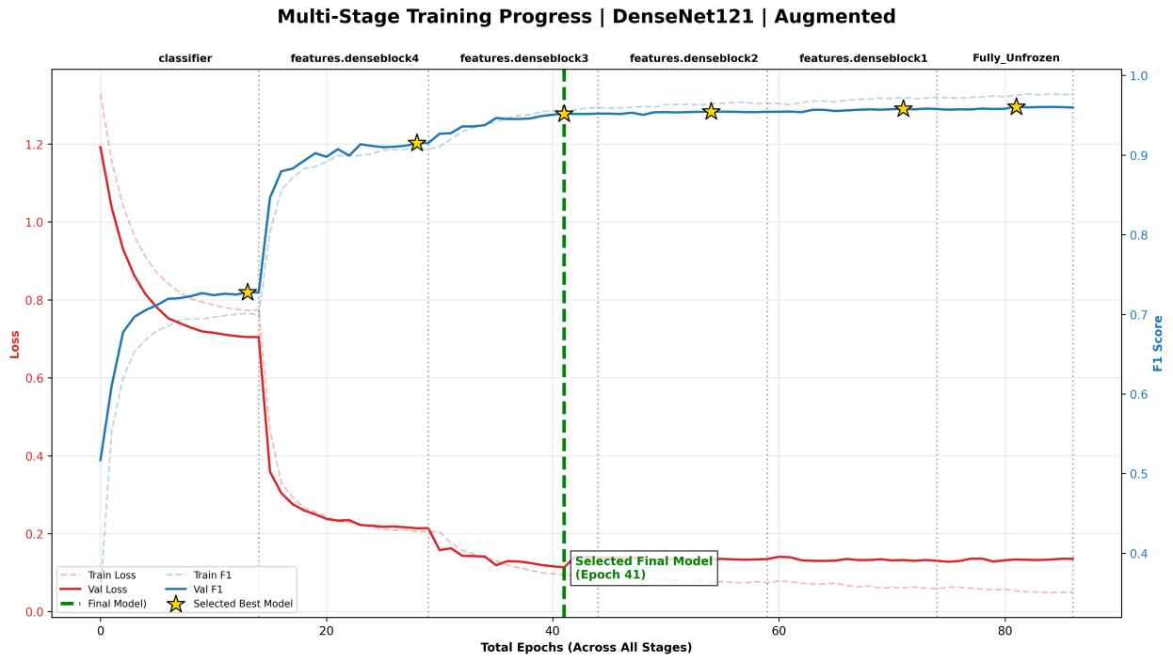
Training Phase of CNNs including “Augmentation”
(C)
(C) RensNet-18 [Augmented] :
F1-score improved to 0.9489.
ECE reduced to 0.0080.
(D) DenseNet-121 [Augmented] :
F1-score improved to 0.9531.
ECE reduced to 0.0081.
Total misclassifications for test set above threshold were only 222 out of 16,699 samples (1.3%).
(D)
*Hard-case mining revealed 327 high-confidence misclassifications within the training set, mainly for CNV and Drusen.
With Augmentation
Smaller Val Loss
Train Loss ∼ Val Loss (Generalization)
Train F1-Score ∼ Val F1-Score
Better Training

Slide 6
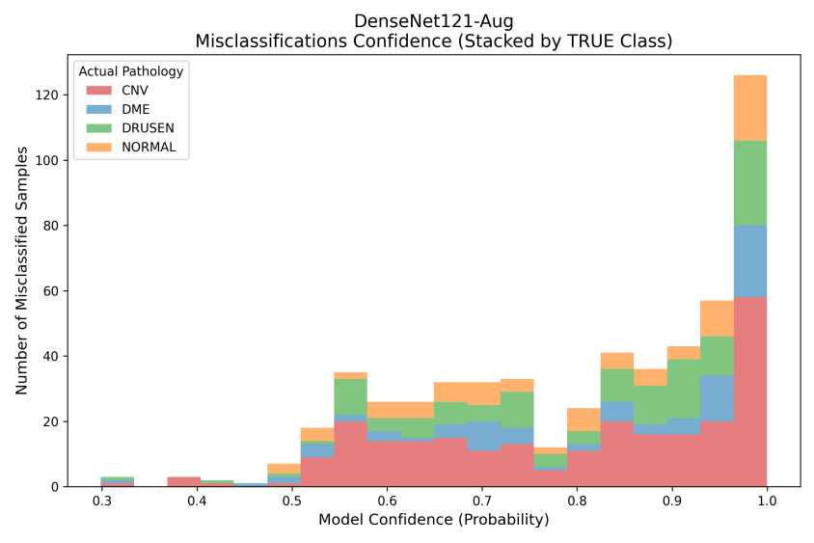
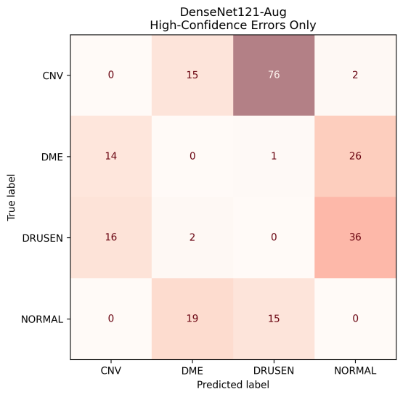
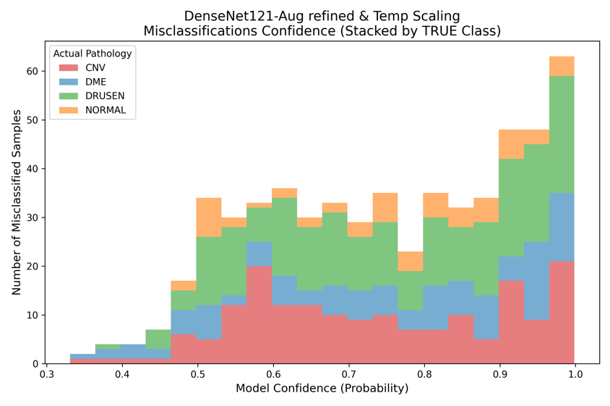
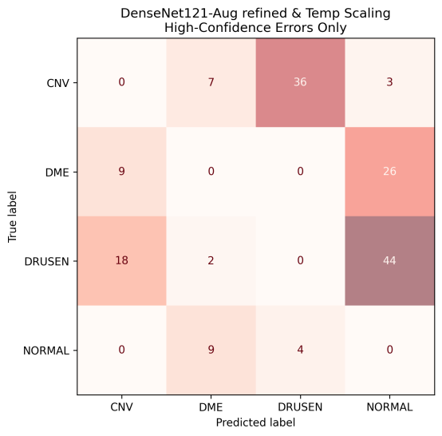
Effects of “Class-Specific Refinement” and “Temperature Scaling”
Un-Refined DenseNet-121-Aug (Figure 4)
Data augmentation proved essential for OCT image analysis, as it enhanced dataset variability and reduced overfitting.
Minimized total errors of test set, primarily below the 0.9 threshold.
(b)
CNV → 1.25%
DME → 1.79%
DRUSEN → 3.15%
NORMAL → 0.65%
AUC values
CNV → 0.998
DME → 0.997
DRUSEN → 0.992
NORMAL → 0.998
(a)
Figure 4: High-confidence error analysis for the unrefined DenseNet121-Aug. (a) Distribution of misclassifications across confidence scores; (b) Confusion matrix for high-confidence (Confidence > 0.9) test set errors.
Refined DenseNet-121-Aug (Figure 5)
Apart from Augmentation:
Class-specific refinement and Temperature scaling reduced the final test set high-confidence error count down to 158 (by 28.8%).
This refinement is important in medical diagnostic applications, as erroneous high-confidence predictions may directly impact clinical decision-making.
(b)
CNV → 0.62%
DME → 1.53%
DRUSEN → 3.73%
NORMAL → 0.25%
AUC values
CNV → 0.998
DME → 0.996
DRUSEN → 0.990
NORMAL → 0.998
(a)
Figure 5: High-confidence error analysis for the refined DenseNet121-Aug. (a) Distribution of misclassifications across confidence scores; (b) Confusion matrix for high-confidence (Confidence > 0.9) test set errors.

Slide 7
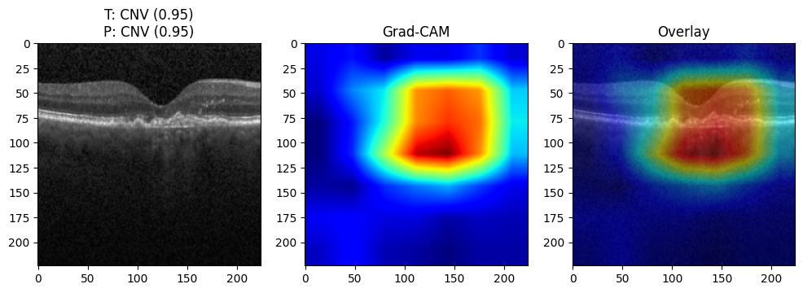
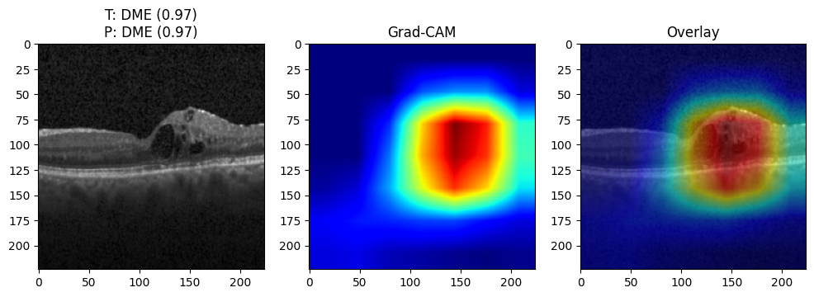
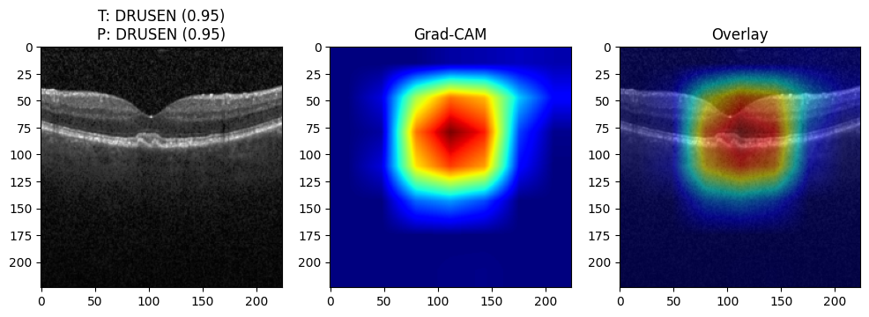
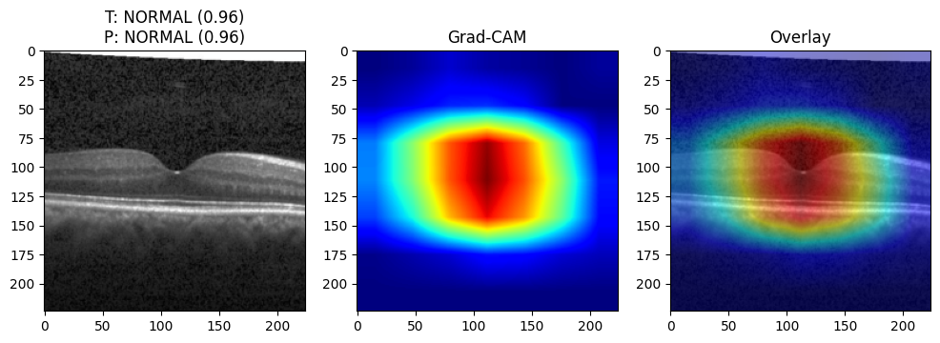
Overall results and Grad-CAM visualization
DensNet-Aug model outperforms slightly ResNet-Aug in terms of Accuracy, Precision, Recall and F1-score.
DensNet-Aug with Hard-Case and Temperature Scaling has an increase in ECE compared to no refinement. This is caused due to the drop in Recall.
Model | ResNet18 |  | DenseNet121
Augmentation - Refinement | Base | Aug | Base | Aug | Aug Refined
Unfrozen layers | First 2 | All | First 3 | All | All
Accuracy | 0.9348 | 0.9637 | 0. 9372 | 0.9666 | 0.9654
Precision | 0.9016 | 0.9442 | 0.9097 | 0.9480 | 0.9548
Recall | 0.9194 | 0.9539 | 0.9123 | 0.9586 | 0.9457
F1 score | 0.9099 | 0.9489 | 0.9110 | 0.9531 | 0.9501
ECE | 0.0085 | 0.0080 | 0.0117 | 0.0081 | 0.0104
Grad-CAM examples of correctly classified OCT images across all categories based on the DenseNet (augmented and refined) model .
Overlay heatmaps illustrate the class-specific activation regions, demonstrating that the network focuses on clinically relevant retinal structures associated with each pathology.
Refined configuration reinforces its potential reliability for clinical decision-support applications
(a)
(b)
(c)
(d)
(e)
(f)
(g)
(h)
GitHub repository [available at: https://github.com/ManosGitProject/oct_retinal_classification_hackathon_V1].

Slide 8
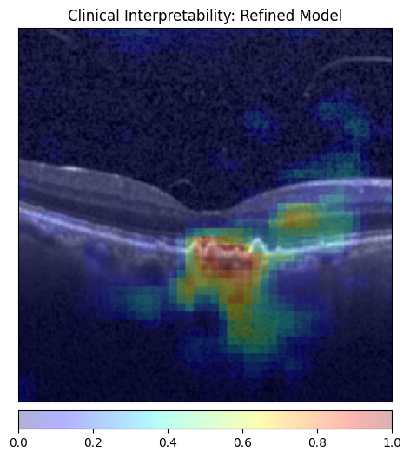
Interpretability – Occlusion Sensitivity
Occlusion Sensitivity technique is used to understand how a CNN makes decisions.
Works by covering (occluding) small parts of an input image and observing how the model’s prediction changes.
If blocking a region causes a large drop in confidence, that region is important for the decision.
Hide part → Check prediction change → Measure importance.
Captures the “lump” in the middle
Also captures some noise

Slide 9
Thank you for your attention

